Slide 1

Continuous Exploration
Continuous Exploration

Slide 2
Agenda
What is CE
Sub-dimensions of CE
Q&A

Slide 3
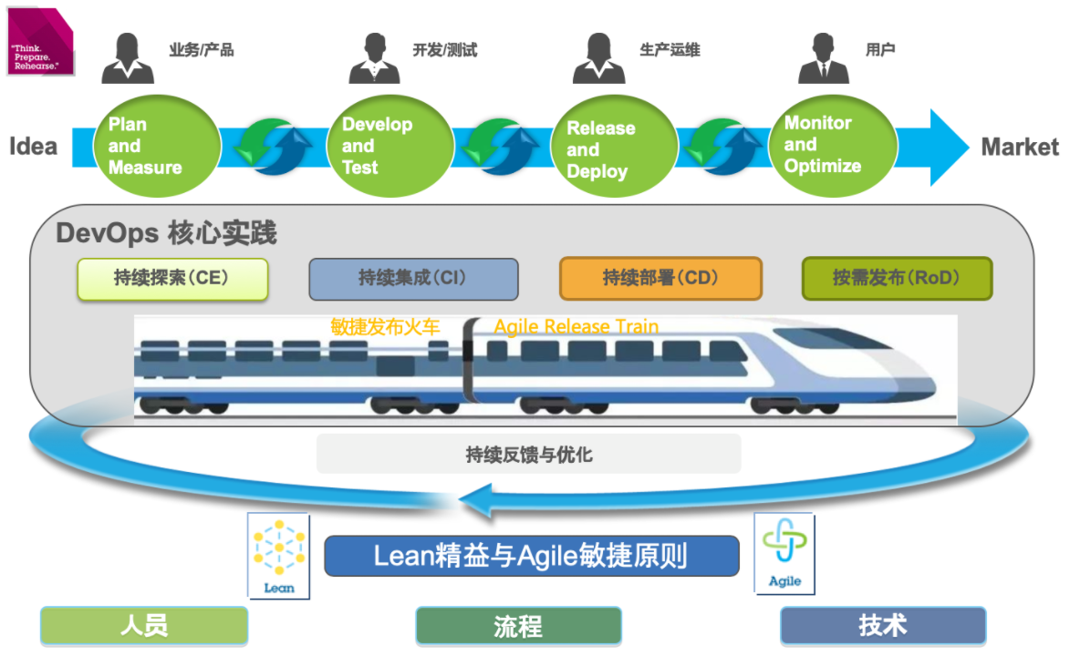

Slide 4
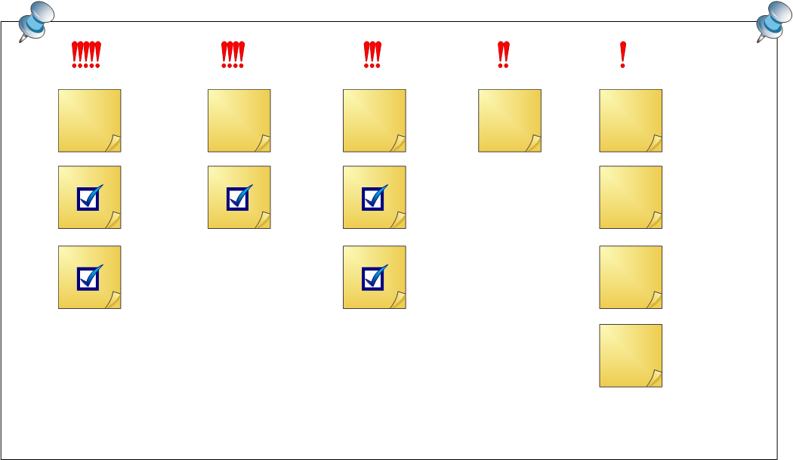
What is CE
CE is a process which facilitates innovation and build the necessary consistency by continuous exploring markets and customer needs and defining product visions, product roadmaps and a rang of features to meet those needs.
The first key practice of DevOps’s core practices.
As we continue to explore, the newly processed ideas are refined to become a prioritized feature list in the requirements to-do list

Slide 5

Sub-dimensions of CE
What-if validation
Collaborative research
Architecture design
Vision integration

Slide 6
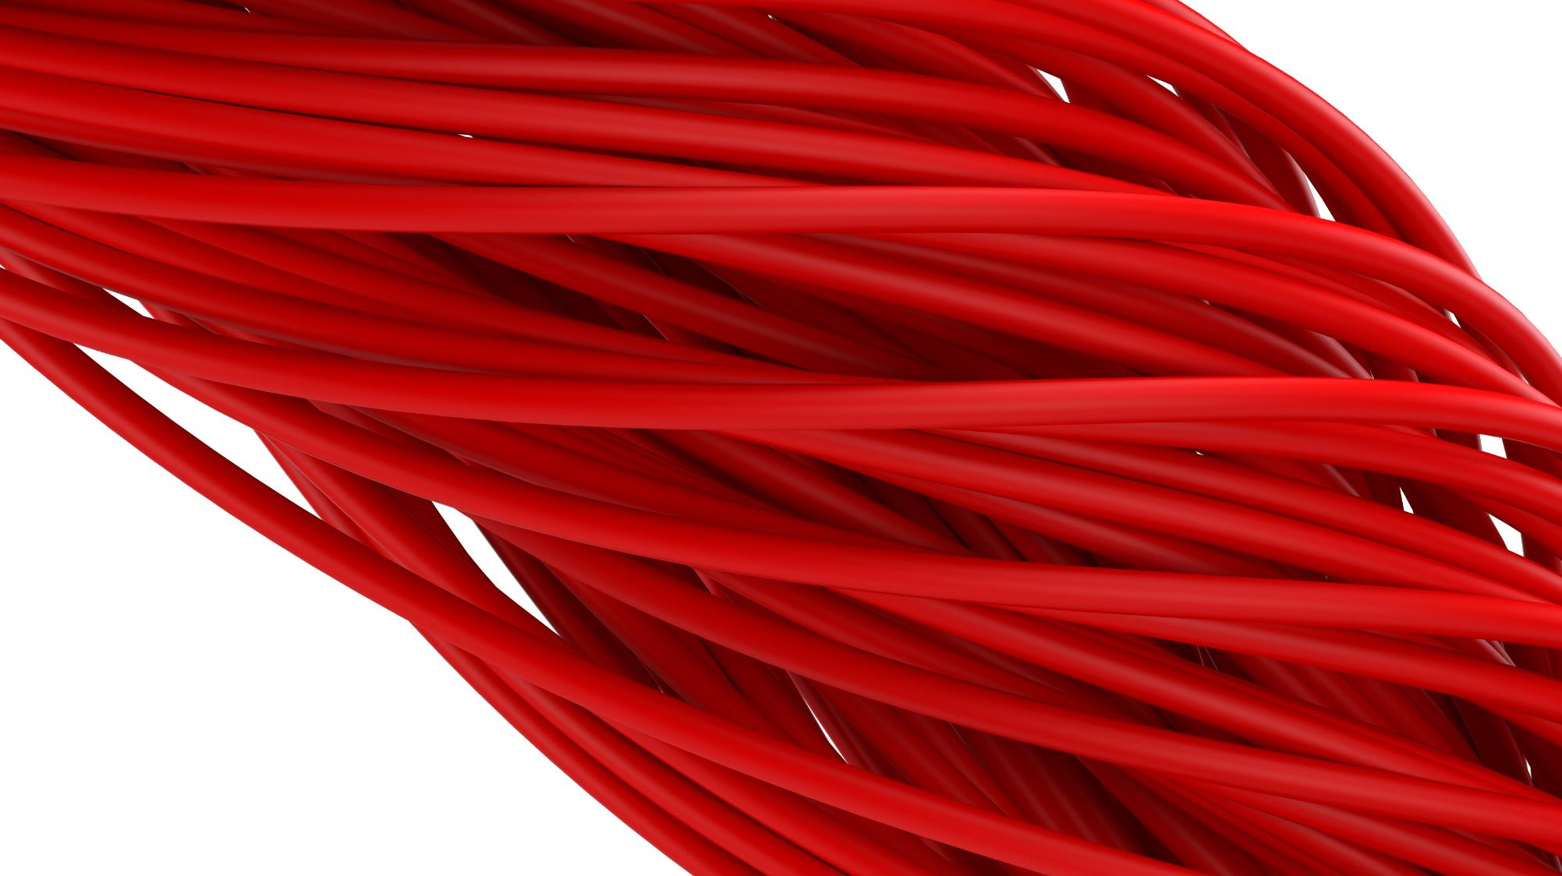
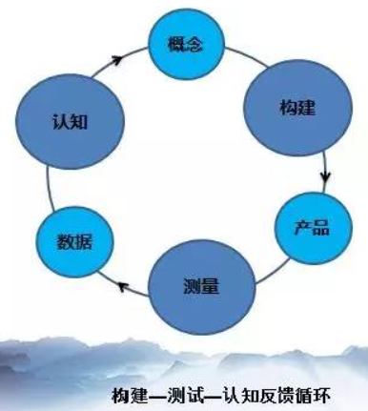
What-if validation
the new inspiration begins with the assumption that people will never know if they are feasible, and that everything needs to be verified
Lean Entrepreneurial Thinking
Minimum Viable Project (MVP)

Slide 7
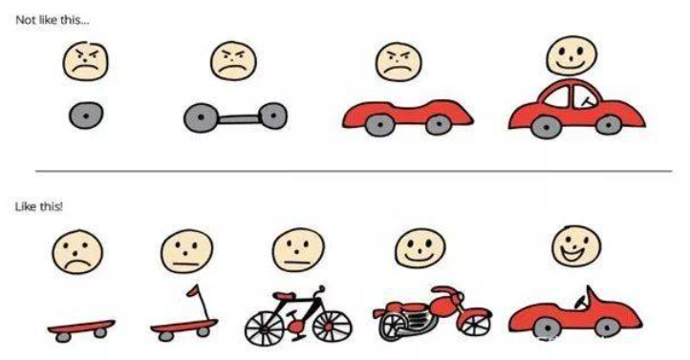
What-if validation

Slide 8
Collaborative research
In order to build a compelling vision of differentiated products, product requirements exploration should be an ongoing collaborative process that should be consulted from different stakeholders.
customer visits
job site work-throughs
trade research
market and competition research

Slide 9
Architecture design
Architecture design is the product of a subjective mapping of elements and relationships within a structure. Architecture design is a series of related abstract patterns that guide the design of all aspects of large software systems, which are critical to creating continuous delivery lines.
Cloud-native architecture; Microserver architecture; Containerized schema; No server schema
Test architecture
Split deployment and release
Operations architecture
Threat modeling

Slide 10
Vision integration
the product vision and product roadmap are integrated into a prioritized list of features to be done
Elevator Presentation
Scenario Roadmap
Benefit prioritization

Slide 11
Q&A

Slide 12
Thank You

